Slide 1
MATH2010 Probability and STATISTICS
Le DUY DUNG
College of Engineering and Computer Science

Slide 2
Update
Dr. Do Van Cuong will run Recitation Session for Section 1 from Week 5
Dr. Le Duy Dung will run Recitation Sessions for Sections 2 and 3 from Week 5

Slide 3
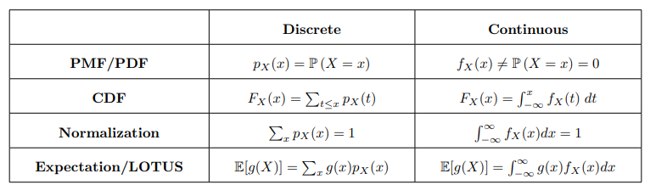

From discrete to Continuous (From Lecture 7)

Slide 4

Learning GOals
Be able to give examples of what uniform, exponential are used to model.
Be able to give the range and PDF of uniform, exponential

Slide 5
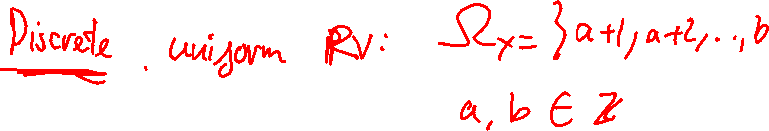
THE (CONTINUOUS) UNIFORM
Random Variable

Slide 6

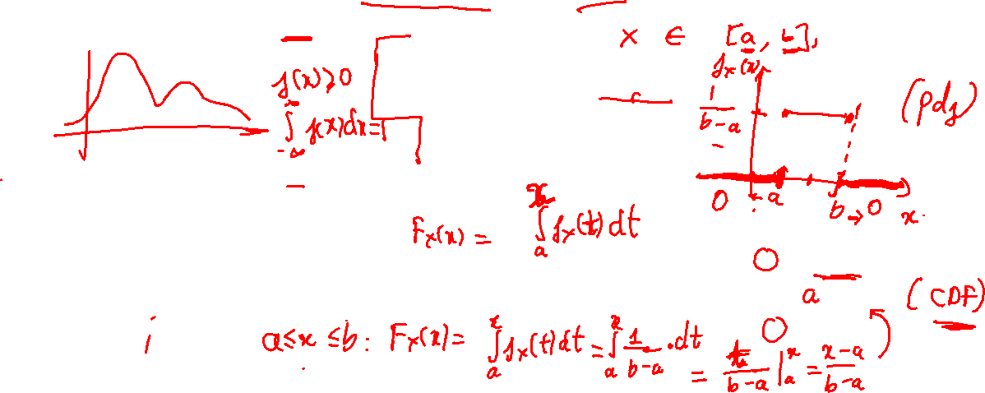



THE (Continuous) UNIFORM RV
Uniform (Continuous) RV: $X \sim Unif(a, b)$ where $a<b$ are real number, if and only if $X$ has the following pdf:
$$f_{X}\left(x\right)= \left\{\begin{aligned}\frac{1}{b−a} x∈[a, b] \\ o otherwise\end{aligned}\right.$$
$X$ is equally likely to take any value in $\left[a, b\right].$
$$F_{X}\left(x\right)=\left\{\begin{aligned}0, x<a \\ &\frac{x−a}{b−a}, ≤x≤b \\ 1, x>b\end{aligned}\right.$$
$$E\left[X\right]=\frac{a+b}{2}$$
$$Var(X)=\frac{{\left(b−a\right)}^{2}}{2}$$

Slide 7
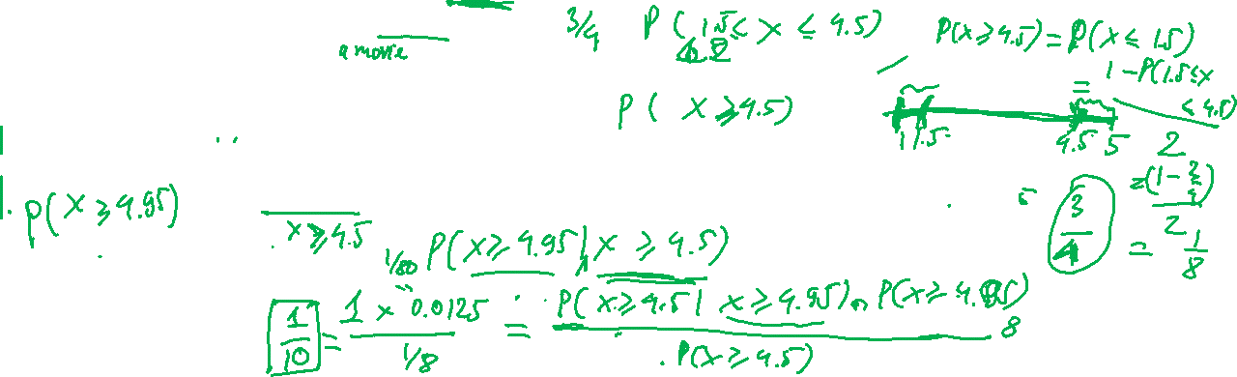
Example
Suppose we think that a Hollywood movie’s overall rating is equally likely to be any decimal value in the interval [1, 5] (this may not be realistic).
A movie is considered average if it is overall rating is between 1.5 and 4.5. What is the probability that is average?
A movie is considered a huge success if its overall rating is at least 4.5. What is the probability that it is a huge success?
A movie is considered legendary if its overall rating is at least 4.95. Given that a movie is a huge success, what is the probability it is legendary?

Slide 8
THE EXPONENTIAL
Random Variable

Slide 9
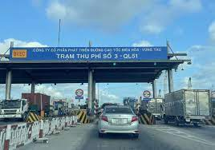
Poisson Distribution:
Number of events that occur in an interval of time
Exponential Distribution:
The time taken between two events occurring
Poisson
Exponential
Number of cars passing a
tollgate in one hour
Number of hours between car arrivals

Slide 10
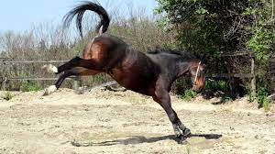
Poisson Distribution:
Number of events that occur in an interval of time
Exponential Distribution:
The time taken between two events occurring
Poisson
Exponential
Number of soldiers killed by
horse-kick per year
Number of years between horse-kick deaths
https://associationofanaesthetists-publications.onlinelibrary.wiley.com/doi/10.1111/anae.13261

Slide 11


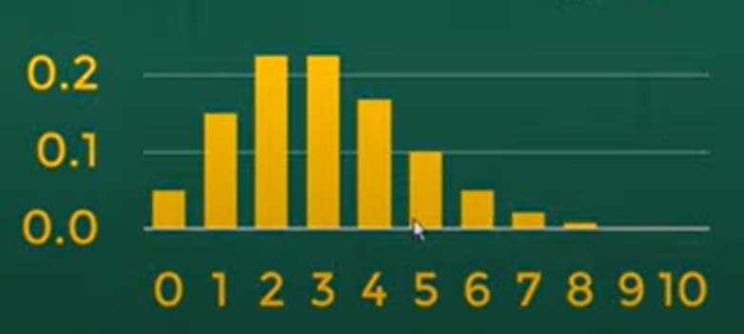
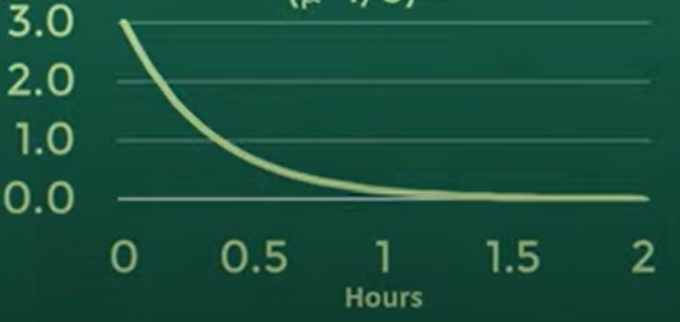

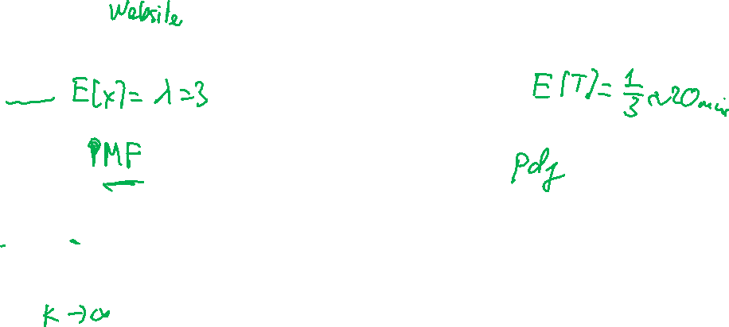

$$X=number of unique visitors per hour$$
$$T=hours between two visitors$$
$$X \sim Poi(λ=3)$$
$$T \sim Exp\left(μ=3\right)$$

Slide 12
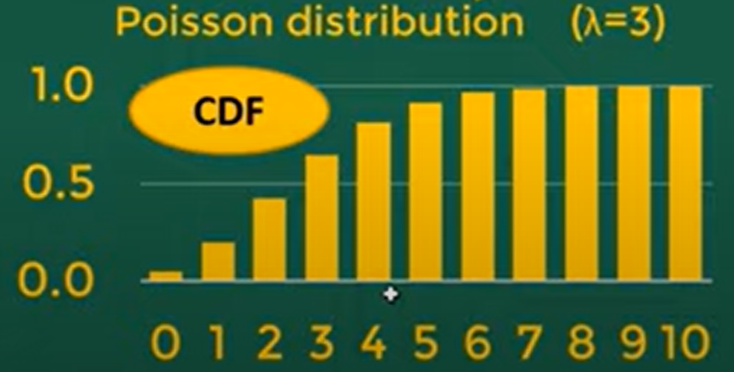
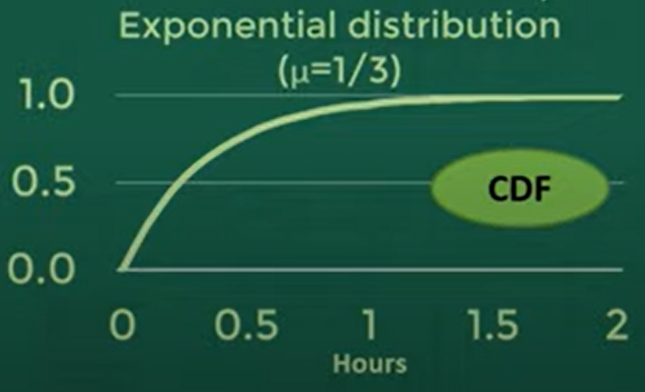
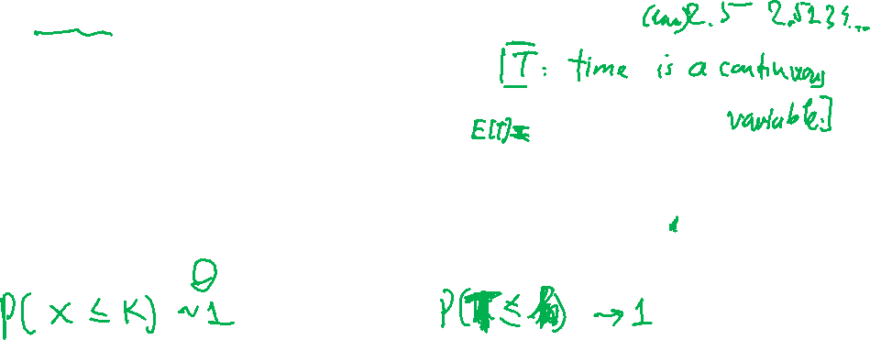
$$X=number of unique visitors per hour$$
$$T=hours between two visitors$$
$$X \sim Poi(λ=3)$$
$$T \sim Exp\left(μ=3\right)$$

Slide 13
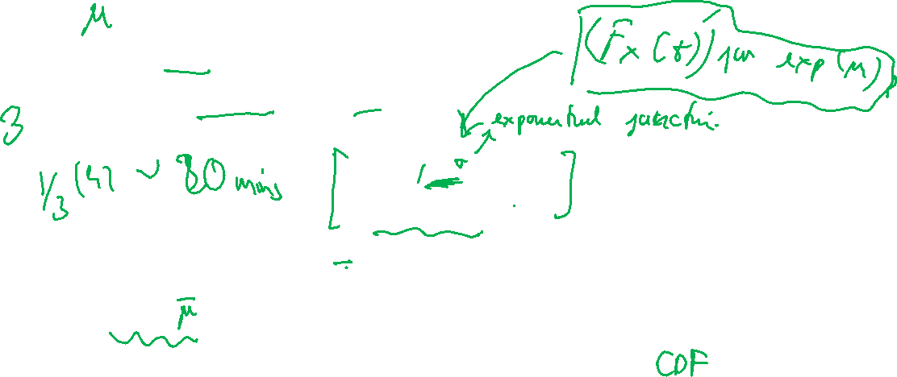





THE EXPONENTIAL Random Variable
$λ$ is the average number of events in 1 unit of time
Range: $[0, ∞).$
Notation: Exponential($μ$) or exp($μ$)
Density:
$$f_{X}\left(x\right)= \left\{\begin{aligned}μe^{−μx} x≥0 \\ o otherwise\end{aligned}\right.$$
$$E\left[X\right]=\frac{1}{μ}$$
$$Var(X)=\frac{1}{μ^{2}}$$
$$F_{X}\left(x\right)=\left\{\begin{aligned}1 −e^{−μx}, x≥0 \\ 0, otherwise\end{aligned}\right.$$

Slide 14
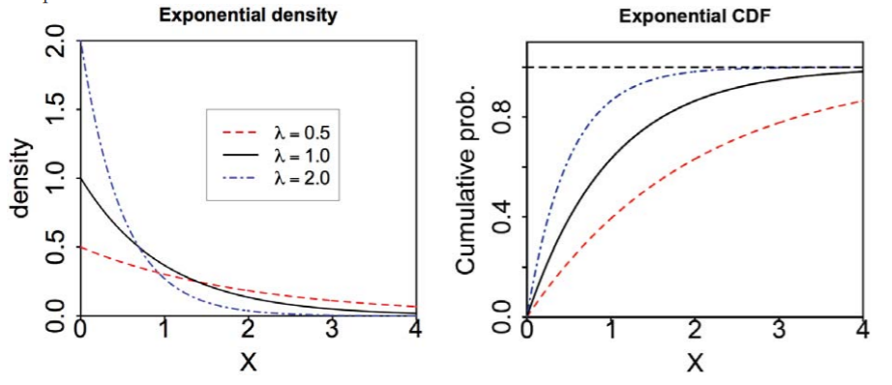
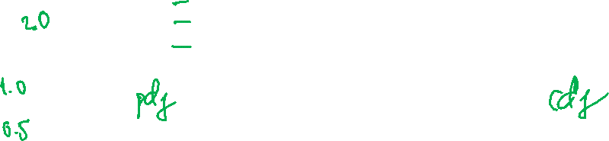



$$μ$$
$$μ$$
$$μ$$

Slide 15

Suppose that, on average, 13 car crashes occur each day on Highway 101. What is the probability that no car crashes occur in the next hour?

Slide 16
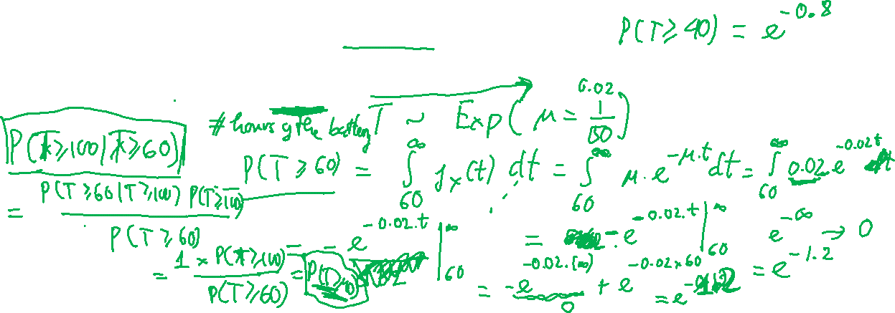
Suppose the average battery life of a VinFast battery is approximately 50 hours.
What is the probability the battery lasts more than 60 hours?
What is the probability the battery lasts more than 40 hours?
What is the probability the battery lasts more than 100 hours, given that the battery has already lasted 60 hours?

Slide 17
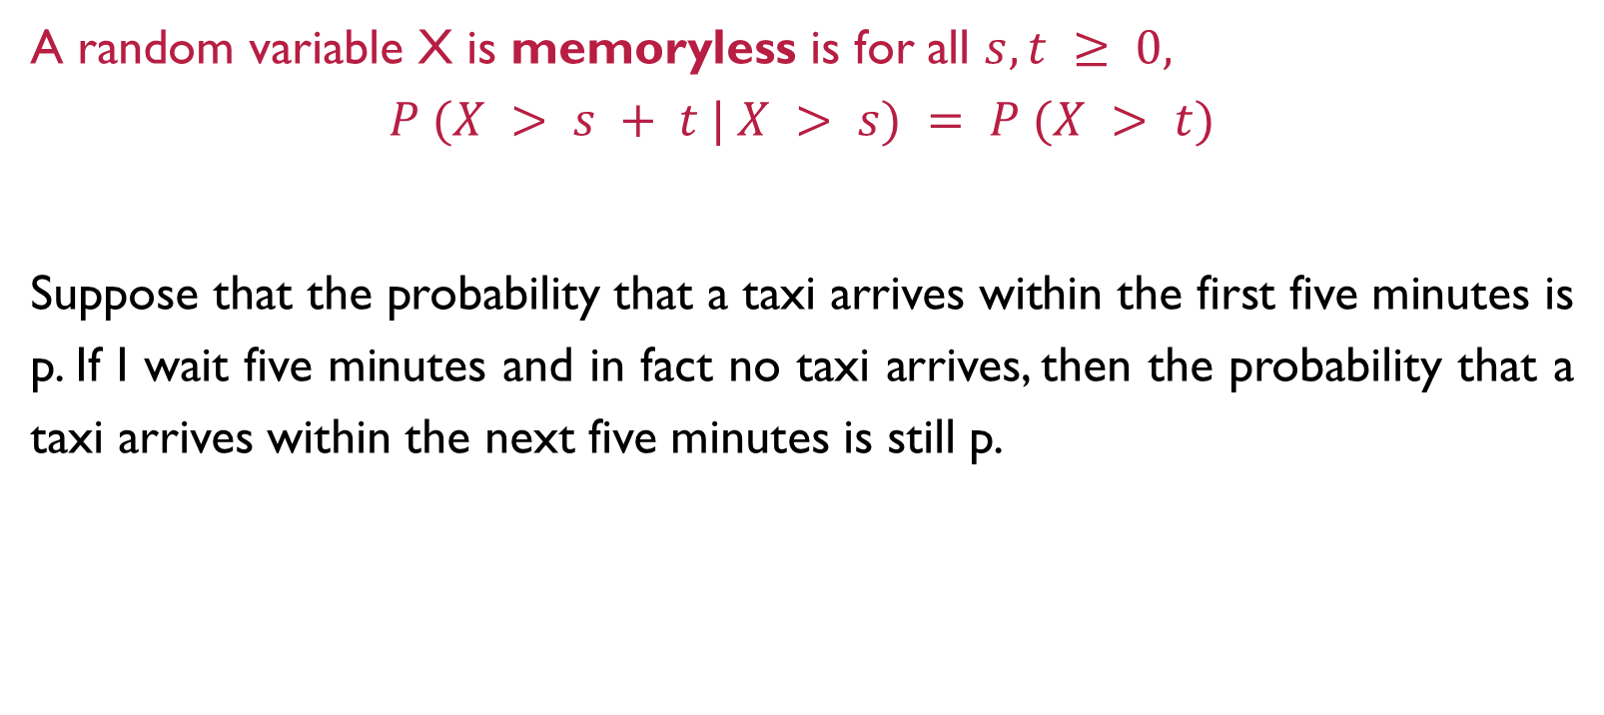
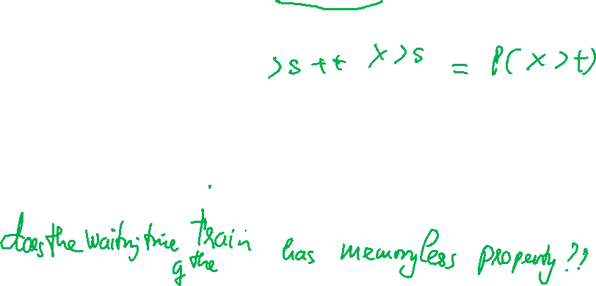
Memorylessness
A random variable X is memoryless is for all $s, t ≥ 0,$
$$P (X > s + t | X > s) = P (X > t)$$
Suppose that the probability that a taxi arrives within the first five minutes is p. If I wait five minutes and in fact no taxi arrives, then the probability that a taxi arrives within the next five minutes is still p.

Slide 18
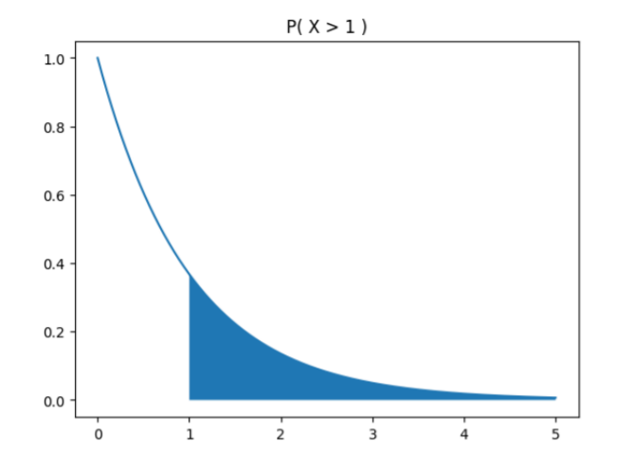
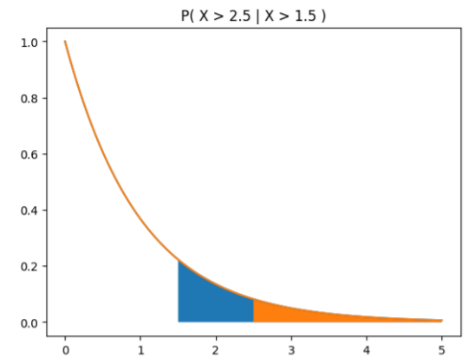
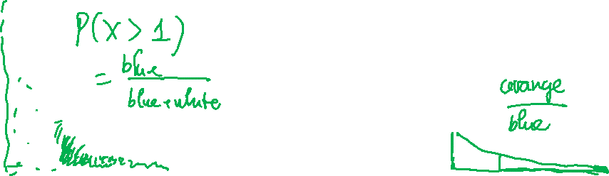
Exponential RV is MEMORYLESS

Slide 19
Summary
Discuss uniform and exponential random variables
Discuss their PDFs, CDFs, expectation and variance
Exponential random variables are memoryless

